Slide 1

ECE-5831 PATTERN RECOGNITION AND NEURAL NETWORKS
Project Proposal
Implementing In-Vehicle Security
Professor: Team:
Azeem Hafeez Raj Kumar Edury
Uttej Thandu

Slide 2
Contents:
Dataset acquisition
Feature Selection
  Standard Deviation
  Settling Time
  Overshoot
Algorithms used
  K-Nearest Neighbor(KNN)
  Gaussian Naïve Bayes
Observations
Current Status and work to do

Slide 3
Dataset acquisition
The dataset is obtained from the data generated by Electronic control units(ECUs)
Dataset consists of data coming from 8 Control Area Networks(CANs)
Each CAN has about 30 samples/files with signal recorded for 599 microseconds.
We extracted features from these 599-microsecond sample.
Dataset size is 8CAN*30files = 240 samples/observations.
We are planning to us 70% of data for training the model and 30% for testing the data.

Slide 4
Feature Selection
We are considering to extracting features such as Standard Deviation and means of Settling Time and Overshoot.
These features give detailed scattering of classes and felt these are unique for CAN data.
Standard Deviation:
  The Standard deviation is the average amount of variability in a given dataset.
  We calculated SD for each sample in CAN data i.e., we got one SD for 599 observations in each file (sample).
  Each CAN has 30 samples, so we got 240 Standard deviations for 8 CANs.

Slide 5
Settling Time:
  Settling time is the time taken for a signal to get within a certain range of the ideal value without subsequently deviating from it by a greater amount.
  We have found settling time for all the dominant values in the dataset and calculated their mean.
  Similar to Standard deviations, we also get 240 values of mean Settling time.
Overshoot:
  Overshoot is an occurrence of a signal exceeding its target value.
  It usually occurs when low pass filters are used.
  From the sample data, we observed that the overshoot is varying significantly for each CAN
  So, we use the mean of overshoot for each sample similar to Settling time.

Slide 6
Algorithms used
Since this is a classification analysis, we have planned to use two methods, they are:
  KNN
  Naïve Bayes
K-Nearest Neighbor:
  In KNN, we classify a sample based on its distance from the centroid of a cluster.
  Generally, we use Euclidean distance for clustering.
Gaussian Naïve Bayes:
  Naive Bayes classifiers are a family of simple "probabilistic classifiers" based on applying Bayes' theorem with strong (naïve) independence assumptions between the features.
  It requires calculation of Likelihood, prior and evidence for every feature for each class.

Slide 7
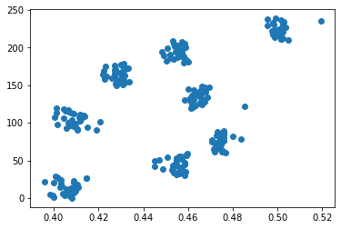
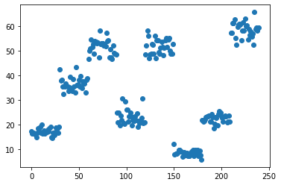
Observations
Plot from Standard Deviation
Plot from Settling time

Slide 8
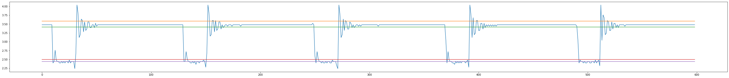
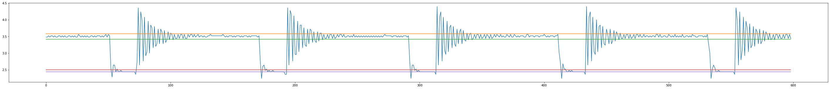
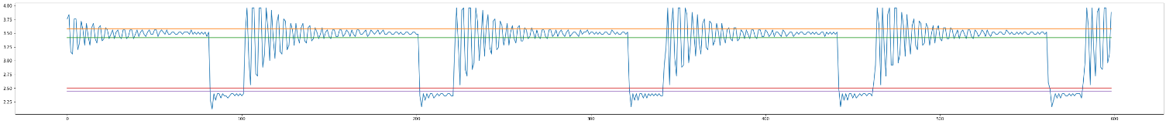
Observations
Overshoot

Slide 9
Current Status and Work to do
We have combined all csv files and brought into shape of (240,599)
Extracted features such as standard deviation, mean of Settling time and overshoot from the dataset.
Normalizing the data, building the model using two methods.
Train the model using 70 percent of the data and test the model using 30% of the data
Performance metrics like accuracy and f1 scores are to be calculated

